Slide 1
Self-Service Desktop Solution

Slide 2

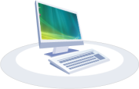

User Self-service Desktop Solution Components
Use
Desktop
XenDesktop
Desktop Access
Windows Desktops
Storefront
Hypervisor
Script
Desktop
Registration
& User
Assignment
Templates
Request & manage
Desktop
CloudPortal Business Manager (CPBM)
CloudPlatform
Desktop Provisioning

Slide 3
Simple Self-Service Desktop UI Architecture
Simple Self-Service Desktop
CPBM
CCP
User UI
List of desktop offerings
Admin Config File
Desktop Connector
List of user owned desktops and basic status
Deploy, power cycle, destroy VM

Slide 4
Admin Create Desktop Offerings
Create Config file used by the simple self-service desktop UI
Desktop offerings (1-n)
Offering name
Description
CloudPlatform zone
CloudPlatform template
CloudPlatform service offering
CloudPlatform disk offering (optional)
CloudPlatform network (optional)
Host name prefix
CloudPlatform domain name for desktop users
Web Receiver URL

Slide 5
User Authenticate into User UI
User enter its AD login/password (CCP uses AD for authentication)
User UI pass the admin provided “domain” to CCP API for login

Slide 6
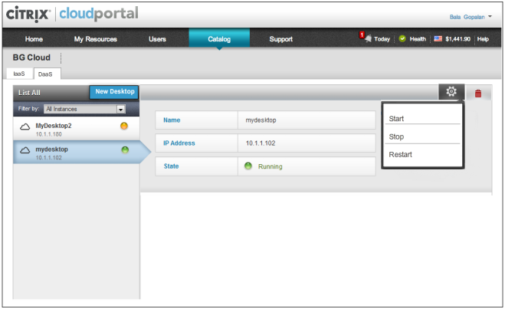
User Manage Desktop
My Desktops
Delete
Web Receiver URL
New simple self-service desktop UI Example
Notes:
User can start/stop/delete its desktop.
Got request to add a way to launch desktop console from CPBM.

Slide 7
User Request Desktop
Select Your Desktop
Windows 7
Description …………………..
Windows 8
Description ………………………
Windows XP
Description ……………………
Submit
Cancel
New simple self-service desktop UI Example
Notes:
But no permission

Slide 8
Desktop Connector
Both desktop connector and CCP connector need to be able to drive the same CCP instance
Admin add desktop users to desktop connector (CCP) through CPBM
Users are created within the admin provided domain name
No nested domains
Admin add desktop products to CPBM
Admin create product in CPBM (do this for each desktop offering)
Select desktop offering
Pick an offering from the list fetched by the CPBM from the Config file
Map product to the offering
Configure pricing
Admin can track usage of desktop products based on metering allocated VMs
Admin create desktop bundles on CPBM (most likely admin will only create utility bundles)
Admin can add desktop offering as entitlement in bundle
Bundles belong to channel catalog, which contains account (this is how permission to desktop offerings can be handled through CPBM)
Admin configure approval process
Configuration in an external file

Slide 9
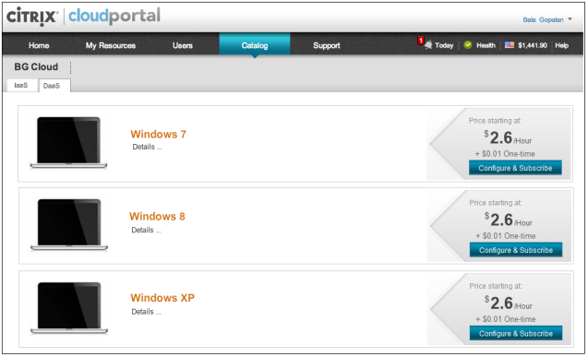
User Request Desktop Subscription UI in CPBM
User submit request
Notes:
This is an example of how it is done through the bundle.

Slide 10
AD Requirements
The AD script will take an input file which shows mapping of AD groups to CPBM profile, and which CPBM tenant account to add the users to (only one tenant account is allowed).
The AD users within the group will be created in the specified CPBM tenant account with appropriate profiles per input file. Before creating a user, the AD script will check if the user exists in the tenant account. It will only create users if it does not already exist. This allows the script to be run periodically by the IT admin to add new users.
Script will out the following:
A list of users added to CPBM and their CPBM profile
A list of users no longer in AD, but in CPBM within the tenant account. This enables IT admin to manually deactivate and delete users from CPBM.
A list of users in CPBM with mismatching profile. This enables IT admin to manually change user profile in CPBM.

Slide 11
Other v1.0 Solution Considerations
Single AD
No support for isolated networks
No support for PVS
Support multiple sites (CCP can span multiple sites. However, XD controller and desktops need to be located at the same site – i.e. cannot cross WAN.)
Need some research to estimate the effort to see if we should do it or not
Notes:
Active Directory Support:
The AD script will take an input file which shows mapping of AD groups to CPBM profile, and which CPBM tenant account to add the users to (only one tenant account is allowed).
The AD users within the group will be created in the specified CPBM tenant account with appropriate profiles per input file. Before creating a user, the AD script will check if the user exists in the tenant account. It will only create users if it does not already exist. This allows the script to be run periodically by the IT admin to add new users.
Script will out the following:
A list of users added to CPBM and their CPBM profile
A list of users no longer in AD, but in CPBM within the tenant account. This enables IT admin to manually deactivate and delete users from CPBM.
A list of users in CPBM with mismatching profile. This enables IT admin to manually change user profile in CPBM.
You can always use professional services.

